Slide 1
Basic I/O Concepts

Slide 2
The WRITE Statement, Revisited
Specifies Where
Specifies How
WRITE(*, *) var1, var2, …
The first field specifies the input/output unit where the data is to be written.
The asterisk in the first field indicates the data is to be written to standard output.
The second field in the parentheses specifies the format in which the data is to be written.
The asterisk in the second field indicates that list-directed output is to be used.

Slide 3
FORMAT Statement
A format is used to specify the exact manner in which variables my be printed or read.
Example:
100 FORMAT(1x,’The results for iteration: ‘,I3,’ are ‘,F10.3)
Text
Statement Label
Format Descriptors

Slide 4
FORMATS and FORMATTED WRITE STATEMENTS
WRITE(*,100) i, result
100 FORMAT (‘ The result for iteration ‘, I3, ‘ is ‘, F7.3)
The statement label of the format statement is included within the parentheses of the WRITE statement.
Format descriptors that describe how the variables are to be written out.
Format descriptor, I3 – specifies that a space 3 characters wide will be used to print out the variable i
Format descriptor, F7.3 – specifies that a space 7 characters wide will be used to print out result, In addition, the variable will be printed with 3 digits to the right of the decimal.
Results :
The result for iteration 21 is 3.142 (formatted)
The result for iteration 21 is 3.141593 (free format)
Note

Slide 5
More on FORMATS
Formats may be specified:
In a FORMAT Statement
In a character constant or variable
Directly in the WRITE statement
Multiple format descriptors in a single format must be separated by commas.

Slide 6
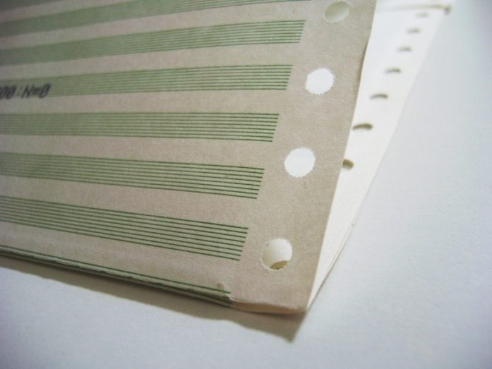
OUTPUT DEVICES
Output from a FORTRAN program will be displayed on a output device:
Line Printers, Laser Printers, Display Screens, etc.
FORTRAN output specifications were designed to output data on a line printer.
Line printer paper
Continuous roll of paper with perforations between pages.
Each page was divided into lines 132 columns wide.
Modern printers
print on individual sheets (either letter or legal size)
Laser printers can be compatible with line printers and respond the same way to output from FORTRAN programs.

Slide 7
Output Buffer
Output Buffer - The computer builds up a complete image of each line in memory before sending it to an output device.
133 characters wide
First character is the control character specifies the vertical spacing for the line.
The rest of the 132 characters contains the data to be printed on the line

Slide 8
FORTRAN 2003 – Column 1
Use of Column 1 as a special control character was a mechanism to work with line printers.
Line printers are nearly extinct.
FORTRAN 2003 has deleted this feature from the standard.

Slide 9
FORMAT Descriptors
Four basic categories:
Descriptors that describe the vertical position of a line of text.
Descriptors that describe the horizontal position of data in a line.
Descriptors that describe the output format of a particular value.
Descriptor that controls the repetition of portions of a format.

Slide 10
More FORMAT Descriptors
The I Descriptor – Integer Output
General form: rIw or rIw.m
Where r is the number of times the format is repeated
Where w represents the width in characters
And m represents the minimum number of digits to display
Integer values output are right justified.
Integer values larger than the allocated space are output as asterisks.
The F Descriptor – Real Output
General form: rFw.d
Where r is the number of times the format is repeated
Where w represents the width in characters
And d represents the number of digits to the right of the decimal to be displayed
Output is right justified
Displayed value will be rounded if internal value has more significant digits than the display format.
Zeros will be added to the displayed value if the internal representation has less significant digits.

Slide 11
Even More FORMAT Descriptors
The E Descriptor – Real Output
General form: rEw.d
Real values are displayed as a number between 0.1 and 1.0 raised to a power of 10.
The ES Descriptor – True Scientific Notation
General form: rESw.d
Outputs a number between 1.0 and 10.0 times a power of 10.
Output is right justified
The L Descriptor – Logical Output
General form: rLw
Outputs the value of a logical variable as either T or F.
Output is right justified.
The A Descriptor – Character Output
General form: rA or rAw
Output is right justified
If the field is not large enough, the variable will be truncated in the display

Slide 12
FORMAT Descriptors, Last Slide
Horizontal Positioning
X descriptor - adding a space
Used to insert one or more blanks into a line.
General form: rX
T descriptor – adding a tab
Used to jump to a specific column
General form: Tc
Repeating Groups of Format Descriptors
It is possible to repeat whole groups of format descriptors by enclosing them in parentheses. Example:
100 FORMAT (1X, 2(I6, 2F10.2))
Format descriptor may be nested as well.
Changing Output Lines
The slash (/) descriptor causes the current buffer to be sent to the printer and a new output buffer to be started.
Each slash starts a new line and that new line has a control character at the beginning.

Slide 13
How Formats are Used During WRITEs
Formats are scanned in order from left to right.
If a format descriptor has a repetitive count associated with it, the descriptor will be used the number of times specified in the repetition count before the next descriptor will be used.
If a group of format descriptors included within parentheses has a repetition count associated with it, the entire group will be used the number of times specified in the repetition count before the next descriptor is used
The use of the format stops at the first format descriptor without a corresponding variable, or at the end of the format, which ever comes first.

Slide 14
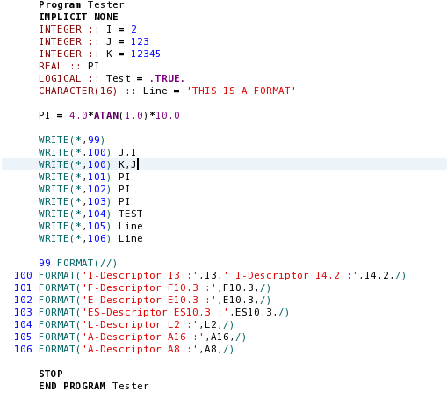
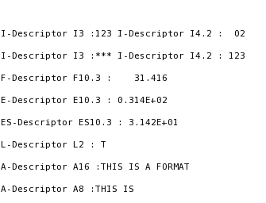
FORMAT Examples:

Slide 15
Formatted READ Statements
Like the formatted write statement, it is possible to specify the exact manner in which the contents of an input buffer are to be interpreted.
Format Descriptors used in formatted READ’s are the same as those found in formatted WRITE’s.
Requires your input file to be precisely formatted.
A better approach is to use a list directed READ statement.

Slide 16
File Processing
A File is a standard structure utilized by FORTRAN to hold data for use in a program.
Consists of one or more lines of related data.
Each line is called a record.
Stored in secondary memory.
Data can be read using both:
Sequential access (data read in consecutive order)
Default access technique used in FORTRAN
Direct access (data read by jumping from one record to another anywhere within the file)
An I/O unit is FORTRAN’s way of selecting the desired file that will either be read or written to.
The I/O unit corresponds to the first asterisk in either the READ(*,*) or the WRITE(*,*) statements.
Replacing the asterisk with a unit number, the corresponding read or write statement will be to the device corresponding to that number.
The I/O unit number must be of type INTEGER.

Slide 17
FORTRAN I/O Control Statements
Certain unit numbers are predefined to be connected to certain input or output devices and don’t require an OPEN statement.
Unit 5 – typically defined at standard input
Unit 6 – typically defined as standard output
Unit 0 – typically defined as standard error
If you need to write to standard input / output / error then use an asterisk.
FORTRAN 2003 has added a special mechanism to allow the user to determine the i/o units associated with standard i/o devices.

Slide 18
The OPEN Statement
OPEN( unit, file, status, action, iostat, iomsg)
UNIT=int_expr clause indicating the i/o unit number to associate with this file.
FILE=char_expr clause specifying the name of the file to be opened.
STATUS=char_expr clause specifying the status of the file to be opened. Where the char_expr is one of the following:
‘OLD’ – Signifies that the file already exists.
‘NEW’ – A new file is created, if a file of the same name exists the open returns an error.
‘REPLACE’ – A new file is created and may overwrite an existing file with the same name.
‘SCRATCH’ – Temporary file that will be deleted automatically when closed
‘UNKOWN’ – We’ll cover in Chapter 14
ACTION=char_expr clause specifying whether a file is to be opened for reading only, for writing only, or for both reading and writing. Where the char_expr is one of the following:
‘READ’
‘WRITE’
‘READWRITE’
IOSTAT=int_var clause specifying the name of an integer variable in which the status of the open operation can be returned.
IOMSG=char_var clause specifying the name of a character variable that will contain a message in an error occurs. (FORTRAN 2003)

Slide 19
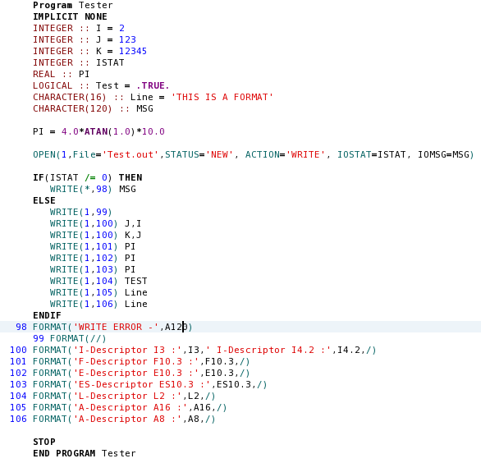
OPEN Statement Example:

Slide 20
The CLOSE Statement
CLOSE(close-list)
Releases the File and the I/O unit associated with it.
On program Termination the file closes automatically.

Slide 21
The IOSTAT in the READ Statement
IOSTAT=int_var
When reading a file:
READ Successful : IOSTAT returns 0
READ Unsuccessful : IOSTAT returns a positive integer corresponding to the system error message.
Reading beyond the end of file:
If no IOSTAT clause is present, any attempt to read beyond the end of file will abort the program.
If IOSTAT clause is present, IOSTAT is set to a negative number.

Slide 22
The IOMSG in the READ Statement
IOMSG=chr_var
NEW in 2003
If the IOMSG clause is included and return i/o status is nonzero, then the character string returned by IOMSG will explain in words what went wrong.
Recommended that the program display this message to the user.

Slide 23
File Positioning
FORTRAN provides two statements that allow us to move around in a sequential file:
BACKSPACE (UNIT=unit)– Moves back one record each time it is called.
REWIND(UNIT=unit)– Moves back to the beginning of the file.
Both statements can also include an IOSTAT= clause to detect errors during the operation.

Slide 24
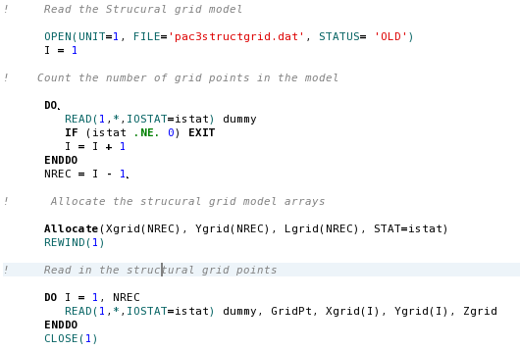
File Positioning Example:

Slide 25
Good Coding Practice
Always be careful to match the type of data in a WRITE statement to the type of descriptors in the format.
Use ES format descriptor instead of E when displaying data in exponential format when displaying output in scientific notation.
Use and asterisk instead of an i/o unit number when reading standard input or writing standard output.
Always open input files with STATUS = ‘OLD’ and ACTION=‘READ’.
Open output files with STATUS=‘NEW’ to create a new output file.
Open output files with STATUS=‘REPLACE’ if you want to overwrite an existing file.
Open scratch files with STATUS=‘SCRATCH’ that will be automatically deleted upon closing.
Always use the IOSTAT= clause when reading from disk files to detect and EOF or error condition.

